Slide 1
Working Capital Management
Chapter 17

Slide 2
Key Concepts and Skills
Understand how firms manage cash and various collection, concentration and disbursement techniques
Understand how to manage receivables and the basic components of credit policy
Understand various inventory types, different inventory management systems and what determines the optimal inventory level

Slide 3
Chapter Outline
Float and Cash Management
Cash Management: Collection, Disbursement, and Investment
Credit and Receivables
Inventory Management
Inventory Management Techniques

Slide 4
Reasons for Holding Cash
Speculative motive – hold cash to take advantage of unexpected opportunities
Precautionary motive – hold cash in case of emergencies
Transaction motive – hold cash to pay the day-to-day bills
Trade-off between opportunity cost of holding cash relative to the transaction cost of converting marketable securities to cash for transactions

Slide 5
Understanding Float
Float – difference between cash balance recorded in the cash account and the cash balance recorded at the bank
Disbursement float
  Generated when a firm writes cheques
  Available balance at bank – book balance > 0
Collection float
  Cheques received increase book balance before the bank credits the account
  Available balance at bank – book balance < 0
Net float = disbursement float + collection float
Notes:
The available balance is more important than the book balance. The firm doesn’t want to bounce checks, but they also don’t want to carry excess cash.

Slide 6
Example: Types of Float
You have $3000 in your bank account. You just deposited $2000 and wrote a cheque for $2500
  What is the disbursement float?
  What is the collection float?
  What is the net float?
  What is your book balance?
  What is your available balance?
Notes:
Disbursement float = $2500
Collection float = -$2000
Net float = 2500 – 2000 = $500
Book balance = $3000 + 2000 – 2500 = $2500
Available balance = $3000

Slide 7
Cash Collection
Payment Payment Payment Cash
Mailed Received Deposited Available
Mailing Time
Processing Delay
Availability Delay
Collection Delay
One of the goals of float management is to try and reduce the collection delay. There are several techniques that can reduce various parts of the delay.
Notes:
Reducing mailing time – lockboxes, Figure 17.1 illustrates how lockboxes can reduce mail delay by having customers mail their payments to PO boxes that are closer to where they live. The processing delay is also reduced because bank employees process the checks instead of the company doing it and then taking the checks to the bank.
Cash concentration – reduce management time by having a systematic process for moving cash received in the lock-boxes to a central account. Allows the company to maintain smaller cash balances overall.

Slide 8
Cash Disbursements
Slowing down payments can increase disbursement float – but it may not be ethical or optimal to do this
Controlling disbursements
  Zero-balance account
  Controlled disbursement account
Notes:
Slowing payments – not ethical to systematically pay bills late; may lose cash discounts by paying late and this can be very expensive
Zero-balance account: maintain a master account, when checks are written on sub-accounts, cash is transferred from the master account to the sub-account to cover the checks; can maintain a smaller overall cash balance by utilizing this technique
Controlled disbursement account – cash is transferred to bank account to cover the day’s anticipated payments

Slide 9
Investing Cash
Money market – financial instruments with an original maturity of one year or less
Temporary Cash Surpluses
  Seasonal or cyclical activities – buy marketable securities with seasonal surpluses, convert securities back to cash when deficits occur
  Planned or possible expenditures – accumulate marketable securities in anticipation of upcoming expenses

Slide 10
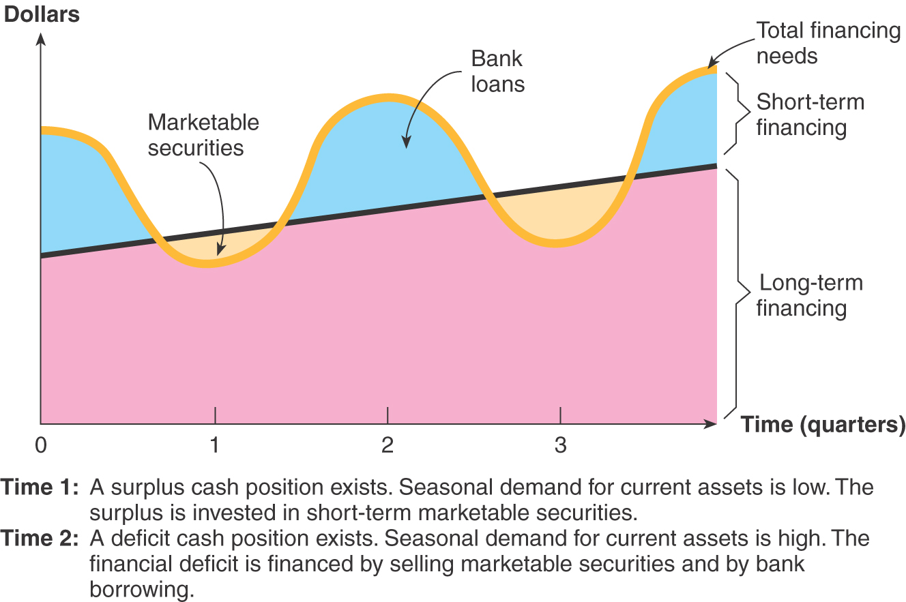
Figure 17.2

Slide 11
Characteristics of Short-Term Securities
Maturity
  Firms often limit the maturity of short-term investments to 90 days to avoid loss of principal due to changing interest rates
Default risk
  Avoid investing in marketable securities with significant default risk
Marketability
  Ease of converting to cash

Slide 12
Credit Management: Key Issues
Granting credit increases sales
Costs of granting credit
  Chance that customers won’t pay
  Financing receivables
Credit management examines the trade-off between increased sales and the costs of granting credit

Slide 13
The Cash Flows from Granting Credit
Credit Sale Cheque Mailed Cheque Deposited Cash Available
Cash Collection
Accounts Receivable

Slide 14
Components of Credit Policy
Terms of sale
  Credit period
  Cash discount and discount period
  Type of credit instrument
Credit analysis – distinguishing between “good” customers that will pay and “bad” customers that will default
Collection policy – effort expended on collecting receivables

Slide 15
Terms of Sale
Basic Form: 2/10 net 45
  2% discount if paid in 10 days
  Total amount due in 45 days if discount not taken
Buy $500 worth of merchandise with the credit terms given above
  Pay $500(1 - .02) = $490 if you pay in 10 days
  Pay $500 if you pay in 45 days

Slide 16
Example: Cash Discounts
Finding the implied interest rate when customers do not take the discount
Credit terms of 2/10 net 45 and $500 loan
  $10 interest (.02*500)
  Period rate = 10 / 490 = 2.0408%
  Period = (45 – 10) = 35 days
  365 / 35 = 10.4286 periods per year
EAR = (1.020408)^{10.4286} – 1 = 23.45%
The company benefits when customers choose to forego discounts
Notes:
Cash discounts are designed to shorten the receivables period, however, you reduce your sales level when discounts are taken.

Slide 17
The Costs of Granting Credit
Cost ($)
Optimal amount of credit
Carrying Cost
Opportunity costs
Amount of credit extended ($)

Slide 18
Credit Analysis
Process of deciding which customers receive credit
Gathering information
  Financial statements
  Credit reports
  Banks
  Payment history with the firm
Determining Creditworthiness
  5 Cs of Credit
  Credit Scoring
Notes:
Credit scoring is less subjective than the five Cs, but firms have to be careful with the information they choose to include in the score, e.g. race, gender and geographic location cannot be included in the score

Slide 19
Five Cs of Credit
Character – willingness to meet financial obligations
Capacity – ability to meet financial obligations out of operating cash flows
Capital – financial reserves
Collateral – assets pledged as security
Conditions – general economic conditions related to customer’s business

Slide 20
Collection Policy
Monitoring receivables
  Keep an eye on average collection period relative to your credit terms
  Use an ageing schedule to determine percentage of payments that are being made late
Collection policy
  Delinquency letter
  Telephone call
  Collection agency
  Legal action
Notes:
If the average collection period is well outside your credit terms, then there is definitely a problem. If you offer a discount and the ACP is not less than your “net” terms, then there is probably a problem. An aging schedule can help you pinpoint if you have customers paying late more or less across the board or if there are a few customers that are paying really late.

Slide 21
Inventory Management
Inventory can be a large percentage of a firm’s assets
Costs associated with carrying too much inventory
Costs associated with not carrying enough inventory
Inventory management tries to find the optimal trade-off between carrying too much inventory versus not enough

Slide 22
Types of Inventory
Manufacturing firm
  Raw material – starting point in production process
  Work-in-progress
  Finished goods – products ready to ship or sell
Remember that one firm’s “raw material” may be another company’s “finished good”
Different types of inventory can vary dramatically in terms of liquidity

Slide 23
Inventory Costs
Carrying costs – range from 20 – 40% of inventory value per year
  Storage and tracking
  Insurance and taxes
  Losses due to obsolescence, deterioration or theft
  Opportunity cost of capital
Shortage costs
  Restocking costs
  Lost sales or lost customers
Consider both types of costs and minimise the total cost

Slide 24
Inventory Management
Classify inventory by cost, demand and need
Those items that have substantial shortage costs should be maintained in larger quantities than those with lower shortage costs
Generally maintain smaller quantities of expensive items
Maintain a substantial supply of less expensive basic materials

Slide 25
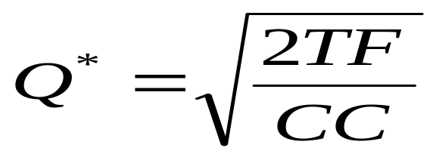
EOQ Model
The EOQ model minimises the total inventory cost
Total carrying cost = (average inventory) x (carrying cost per unit) = (Q/2)(CC)
Total restocking cost = (fixed cost per order) x (number of orders) = F(T/Q)
Total Cost = Total carrying cost + total restocking cost = (Q/2)(CC) + F(T/Q)
Notes:
The optimal order quantity is where the cost function is minimized. This will occur where total carrying cost = total restocking cost. If your students have had calculus, you can have them verify that taking the derivative, setting it equal to zero and solving for Q provides the same result.

Slide 26
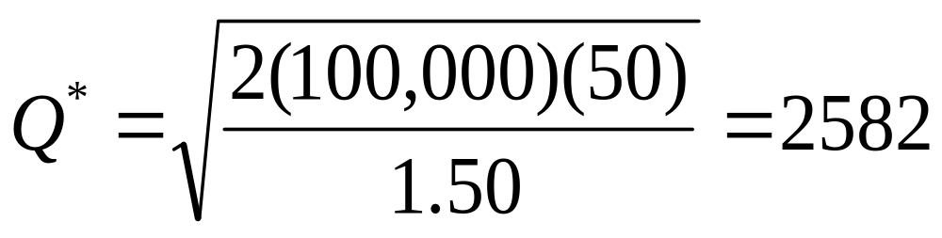
Example: EOQ
Consider an inventory item that has carrying cost = $1.50 per unit. The fixed order cost is $50 per order and the firm sells 100,000 units per year.
  What is the economic order quantity?
Notes:
Total carrying costs = (2582/2)(1.50) = 1936.50
Total restocking costs = 50(100,000)/2582 = 1936.48

Slide 27
Extensions
Safety stocks
  Minimum level of inventory kept on hand
  Increases carrying costs
Reorder points
  At what inventory level should you place an order?
  Need to account for delivery time
Derived-Demand Inventories
  Materials Requirements Planning (MRP)
  Just-in-Time Inventory

Slide 28
Quick Quiz
What is the difference between disbursement float and collection float?
What is credit analysis and why is it important?
What is the implied rate of interest if credit terms are 1/5 net 30?
What are the two main categories of inventory costs?
What components are required to determine the economic order quantity?
Notes:
Implied rate of interest = (1 + 1/99)^{(365/25)} – 1 = 15.80%

